Slide 1
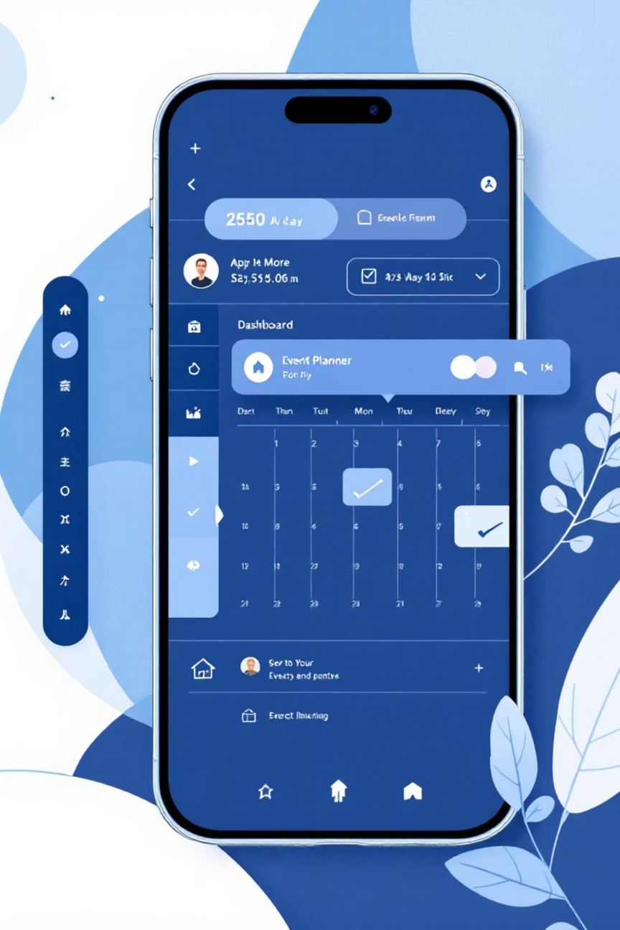
EventMate
AI-Powered Event Planning Simplified
Your all-in-one platform for stress-free event management

Slide 2

The Event Planning Challenge
Planning events shouldn't mean juggling spreadsheets, notes, and multiple apps. Today's event planners face real friction points:
Scattered Details
No Structure
Poor Coordination
Event info fragmented across email, notes, and messaging apps—nothing centralized
Hard to track essentials: date, venue, guests, special requirements, budget
Confusion and missed details lead to stress and subpar event execution

Slide 3


Meet EventMate
One platform. All your events. Zero stress.
Centralized Hub
Step-by-Step Forms
Manage all event details in one secure, organized space
Structured workflows guide you through every event planning phase

Slide 4
What EventMate Delivers
Navigation Bar
Service Categories
Structured Event Forms
One-click access to all features and services
Browse Birthday, Wedding, Party, Camping, and more
Tabbed interface for details, timing, venue, and guests
Contact & Coordination
Secure Authentication
Integrated contact page with map and messaging
Login and signup with encrypted user accounts

Slide 5

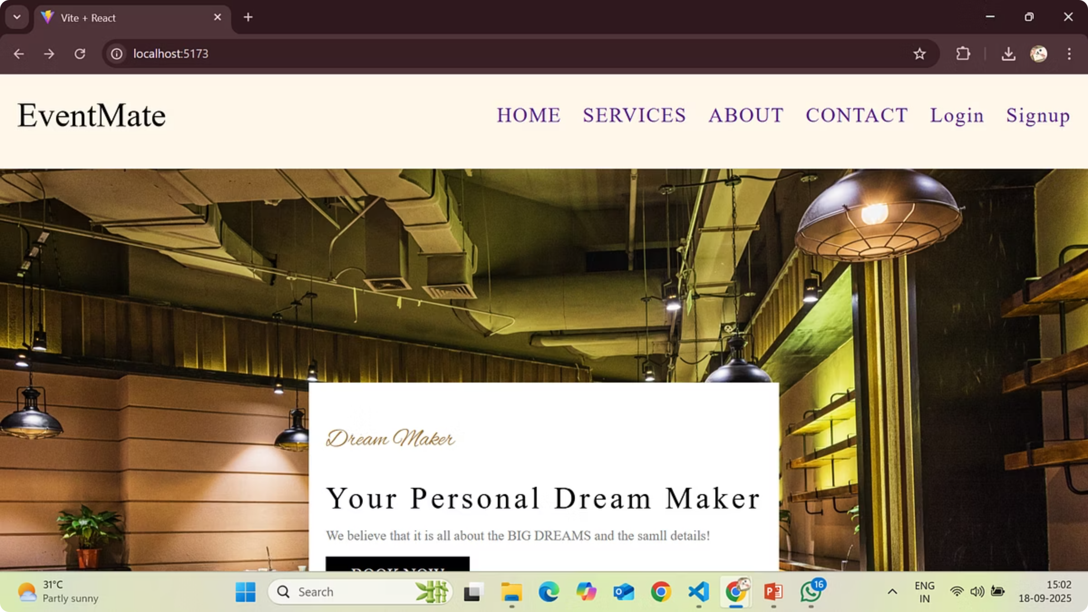

Core Experience
Hero Section & Call to Action
First Impression Matters. The hero section instantly communicates EventMate's purpose with compelling branding and a clear "Book Now" button powered by React and smooth scroll navigation.
User lands → Reads tagline → Clicks "Book Now" → Navigates to services or contact section

Slide 6
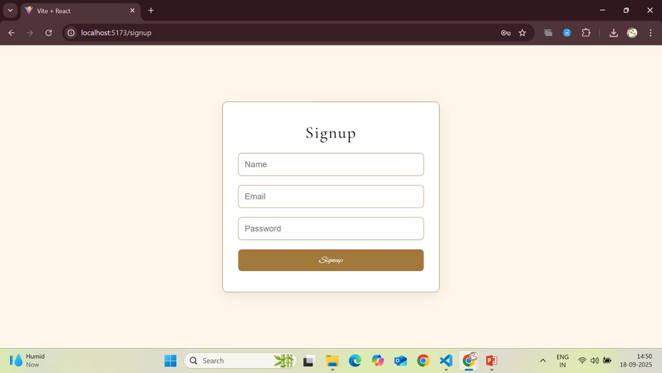
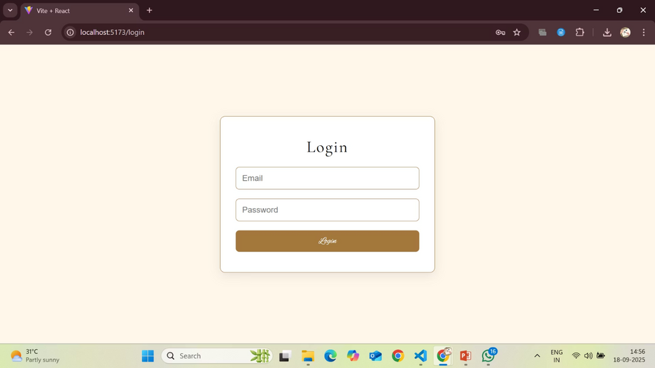
Authentication
Secure Signup & Login
Signup Page
Login Page
New users create accounts with name, email, and secure password using React's controlled components
Existing users authenticate with email and password to access their event dashboard

Slide 7

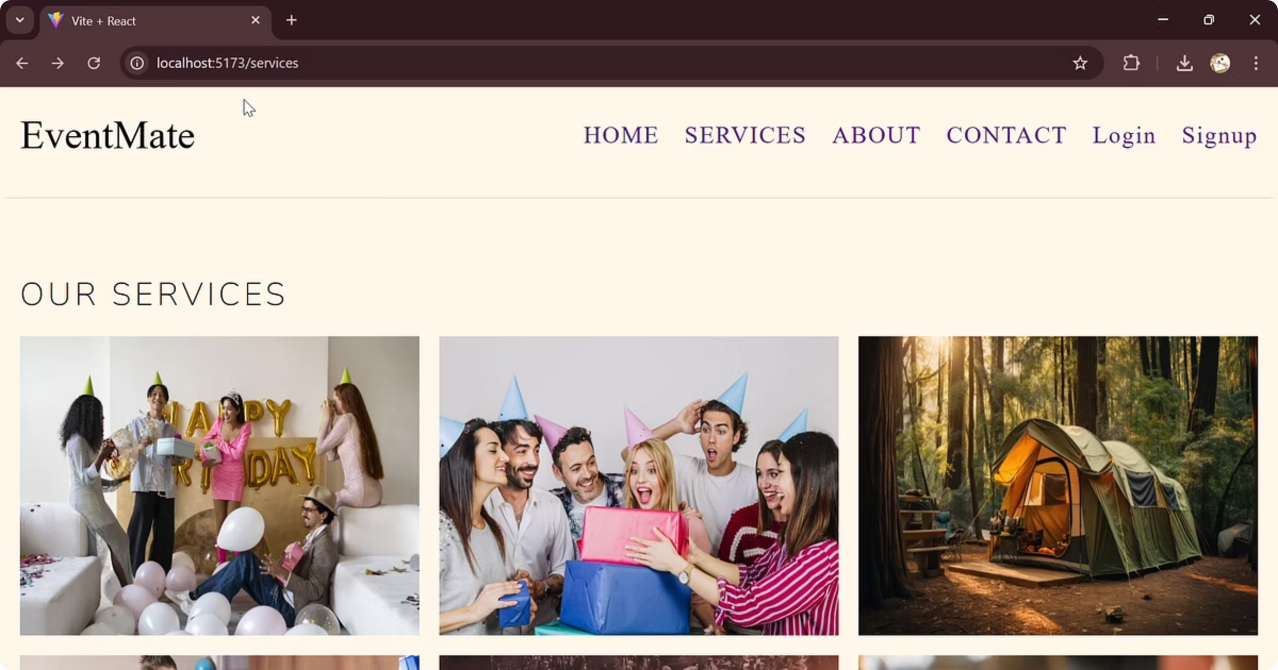
Service Selection
Browse Event Categories
Users select from diverse event types—Birthday, Wedding, Party, Camping, and more. Each category is clickable and routes to a customized event creation form using React Router's dynamic navigation.
Select service → Customize event details → Book your perfect event

Slide 8

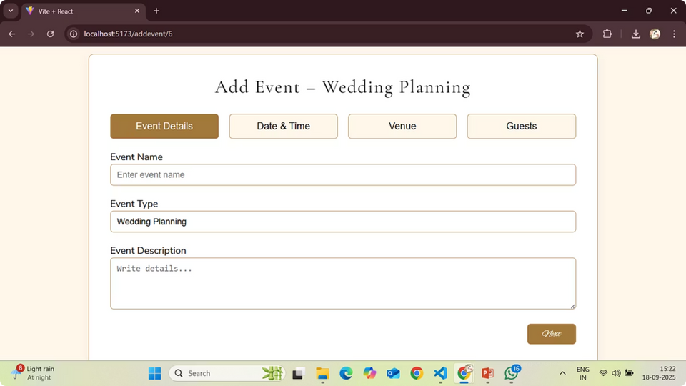
Event Creation
Seamlessly customize and book events through an intuitive multi-step form
Guided Experience
Multi-step tabs walk users through event details progressively
Flexible Customization
Full control over services, dates, times, and special requirements
React-Powered
Built with React Hooks for responsive, real-time form handling

Slide 9

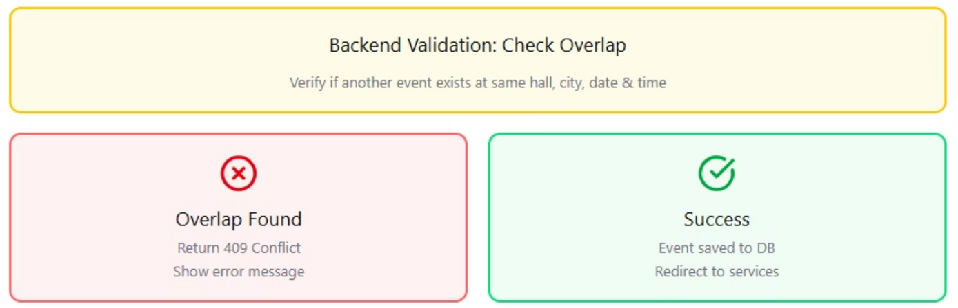
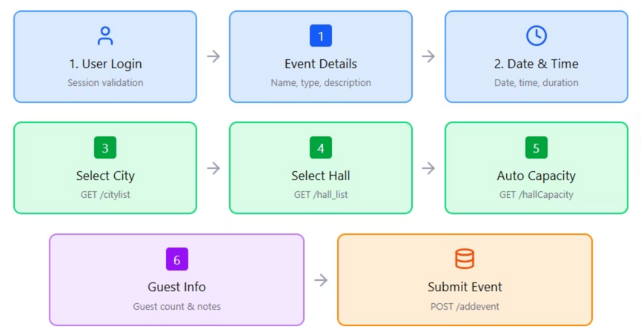
Add Event Process
Step-by-step event booking and submission workflow

Slide 10

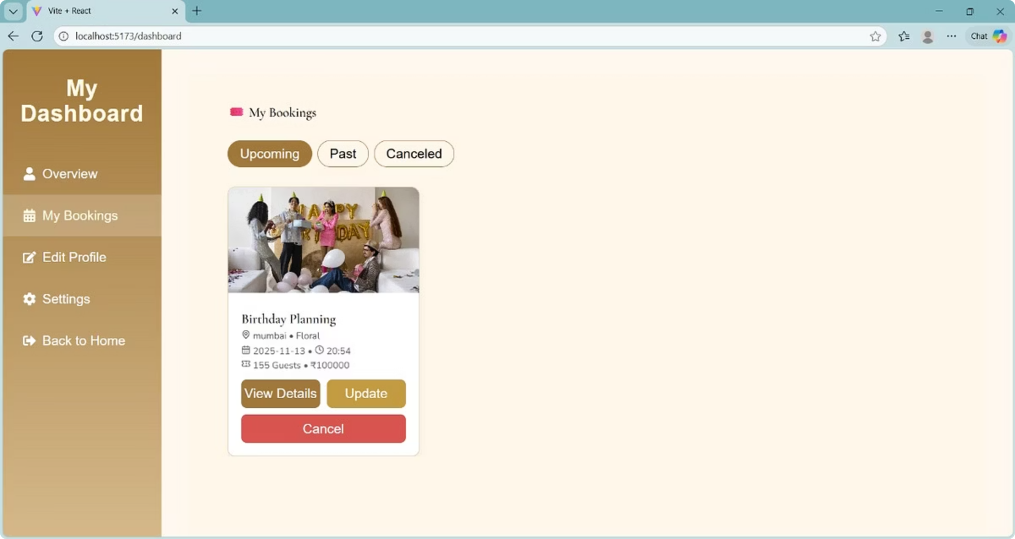
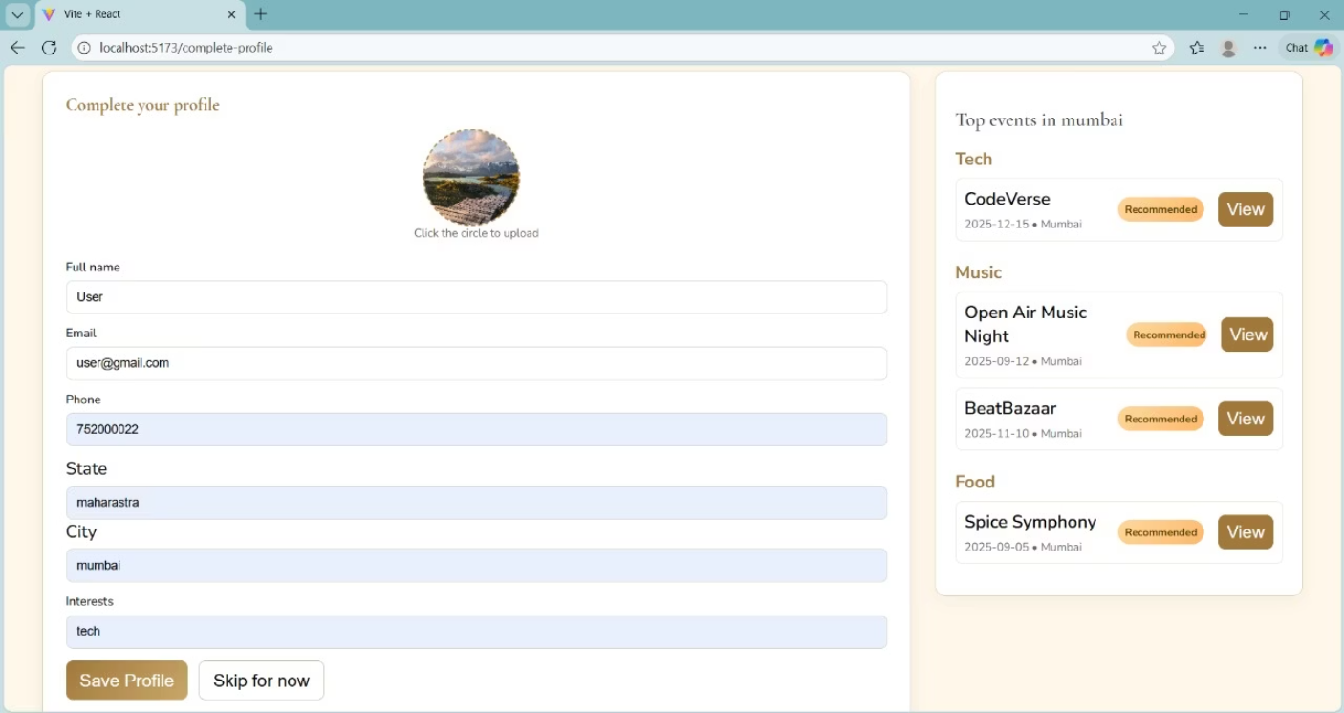
Event Management Platform
React & Vite dashboard with personalized booking and profile management
Dashboard
Comprehensive booking overview with event details and status tracking
Profile Completion
User preferences and interest-based event recommendations
Personalization
Smart recommendations aligned with user interests and attendance history

Slide 11
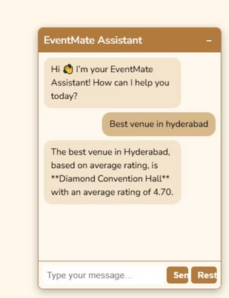
The EventMate Assistant
AI-Powered Venue Intelligence
Revolutionizing how event planners discover venues through intelligent, data-driven recommendations powered by natural language processing.
Instant Natural Language Queries
Real-Time Data Grounding
Objective, Rating-Based Results
Ask questions naturally—"Best venue in Hyderabad"—and receive precise, ranked recommendations instantly.
The assistant queries your complete venue database live, ensuring results reflect current ratings and availability.
Recommendations are calculated purely on average ratings and location criteria—no bias, just actionable intelligence for smarter decisions.
Proven Performance: Query "Best venue in Hyderabad" returns Diamond Convention Hall with a 4.70 average rating—transforming structured data into immediate, competitive advantage.

Slide 12

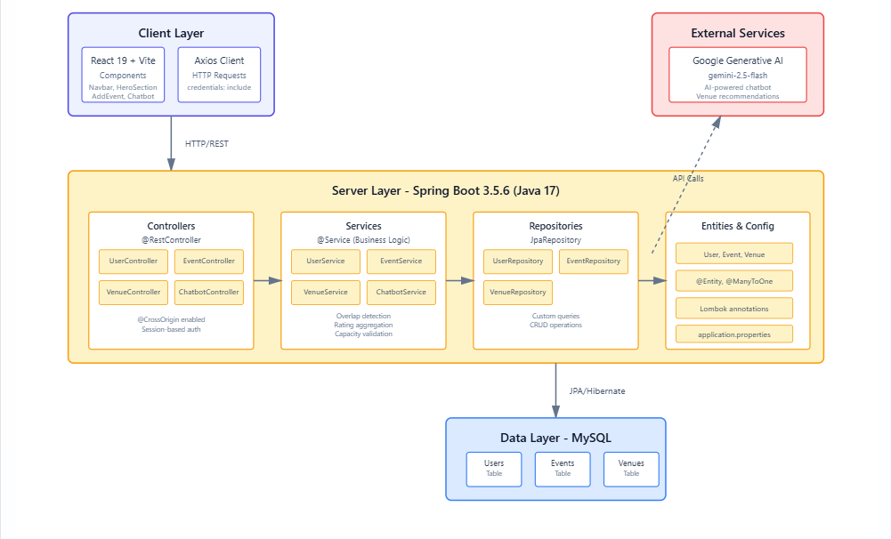
System Overview
Complete end-to-end platform delivering event planning solutions
Frontend Experience
Secure Backend
Intuitive React interface for event creation and management
Spring Boot API handling authentication and data validation
Reliable Database
Structured storage for users, events, and booking history

Slide 13

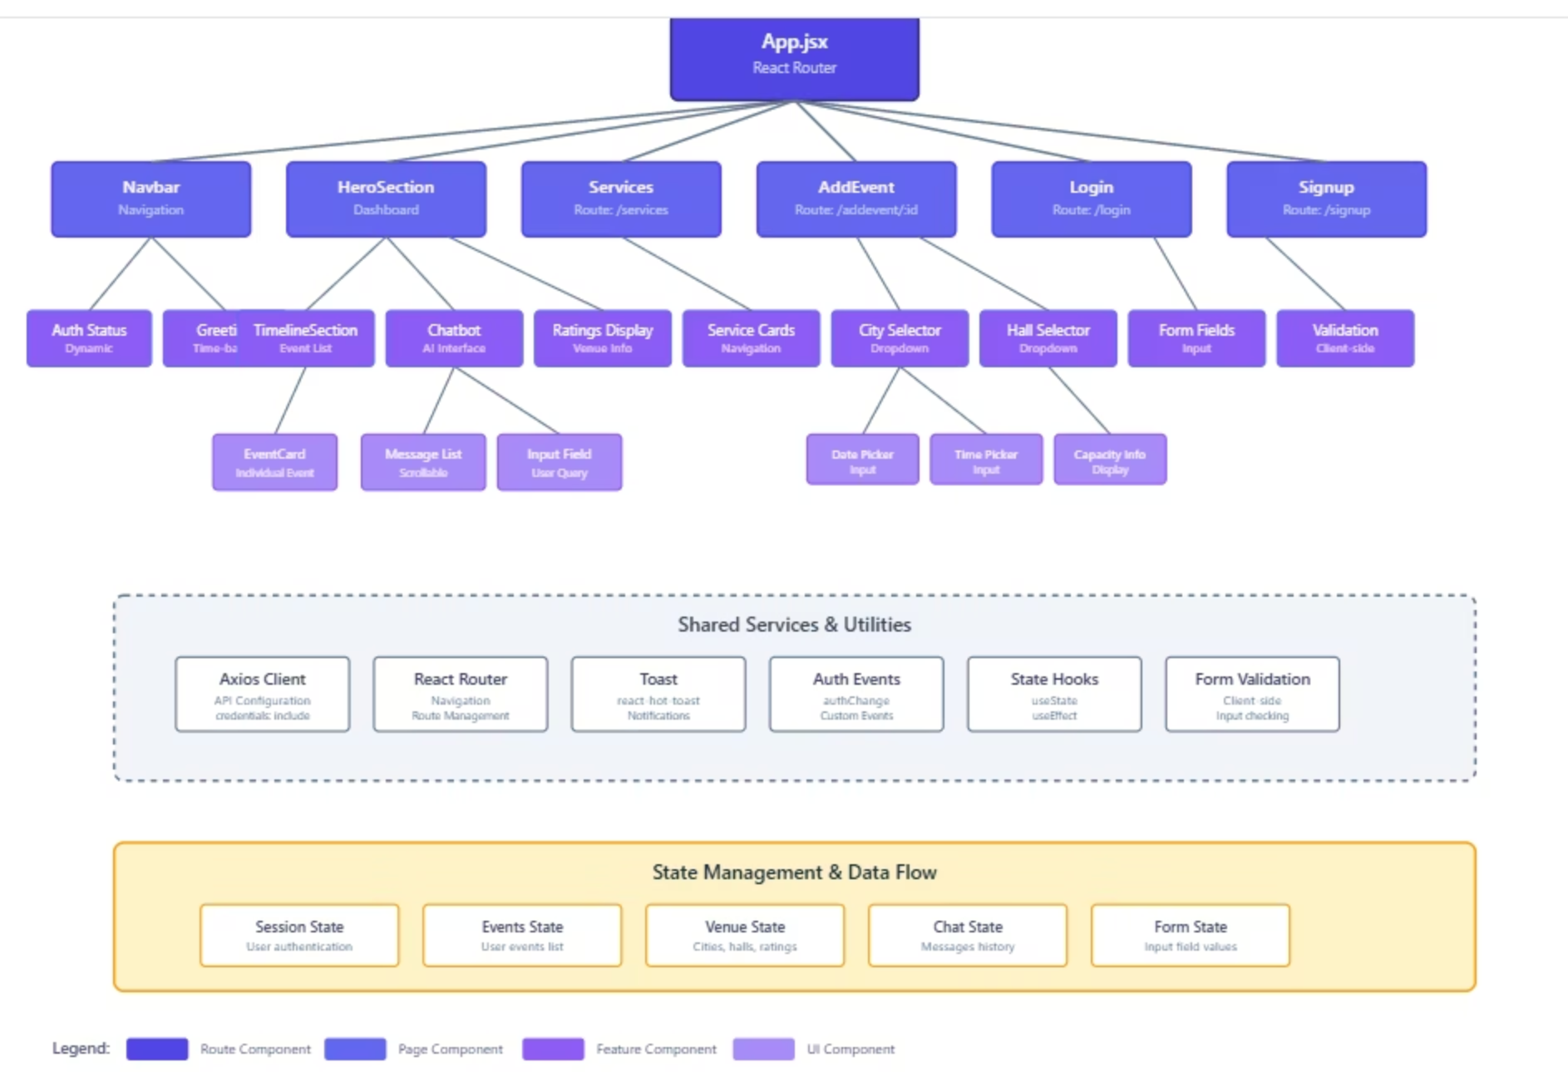
Frontend Architecture – React Layer
Framework: Built using React 19 + Vite with modular component structure and React Router for navigation.
Component Hierarchy:
App.jsx serves as the root router managing navigation between routes like AddEvent, Login, and Signup.
Navbar, HeroSection, and Services components handle UI layout and dashboard display.
AddEvent component manages event creation with dynamic selectors for city, hall, and capacity validation.
Shared Services & Utilities:
Axios Client for API communication.
React Router for navigation and state synchronization.
State Hooks (useState, useEffect) for UI reactivity.
Form Validation and Auth Events for input checks and session control.
State Management & Data Flow:
Includes states for Session, Events, Venues, Chat, and Forms.
Enables smooth data flow between UI components and backend services.

Slide 14

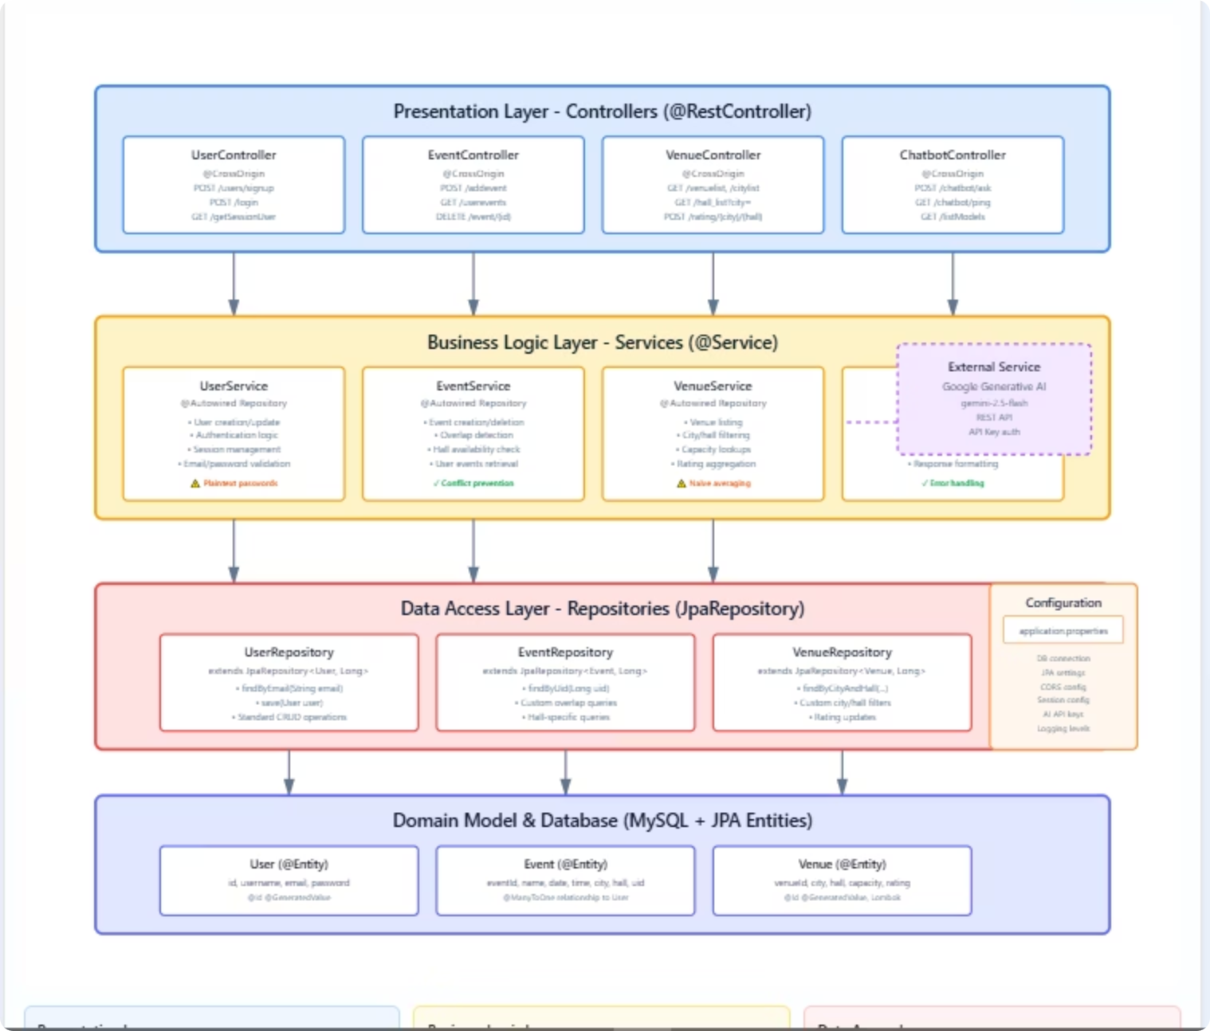
Backend Architecture – Layered Design
Presentation Layer (Controllers):
Handles REST API endpoints using @RestController.
Includes controllers for User, Event, Venue, and Chatbot.
Implements @CrossOrigin for frontend integration and session-based authentication.
Business Logic Layer (Services):
Core processing handled via @Service classes.
Contains UserService, EventService, VenueService, and ChatbotService.
Performs authentication, validation, conflict prevention, and AI-based venue recommendations.
Integrates with Google Generative AI (gemini-2.5-flash) for chatbot and recommendation features.
Data Access Layer (Repositories):
Uses JpaRepository interfaces for CRUD and custom queries.
Supports filtering, aggregation, and event overlap detection.
Domain Model & Database:
MySQL database mapped using JPA Entities (@Entity, @ManyToOne).
Tables: User, Event, Venue ensuring referential integrity and data consistency.

Slide 15
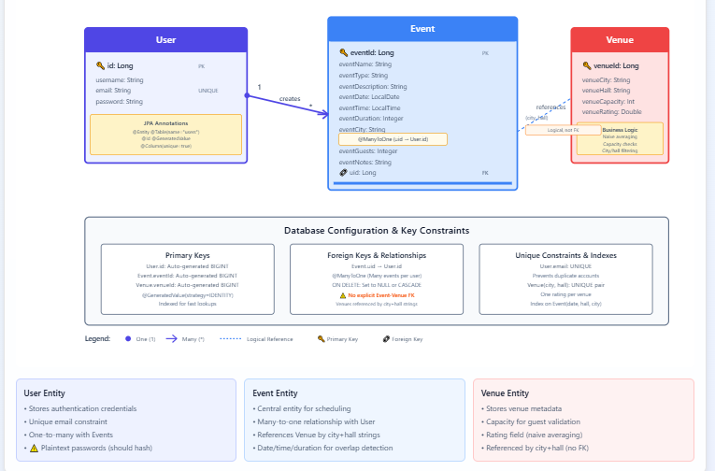
Database Architecture & Entity Relationships
EventMate's database schema establishes three core entities that work together seamlessly:
User Entity
Event Entity
Stores organizer profiles with authentication details and event preferences
Manages event metadata, dates, times, and capacity requirements
Venue Entity
Maintains venue details, availability windows, and capacity constraints
The schema implements primary keys for unique identification, foreign keys for referential integrity, and data constraints that prevent scheduling conflicts and overbooking automatically.

Slide 16
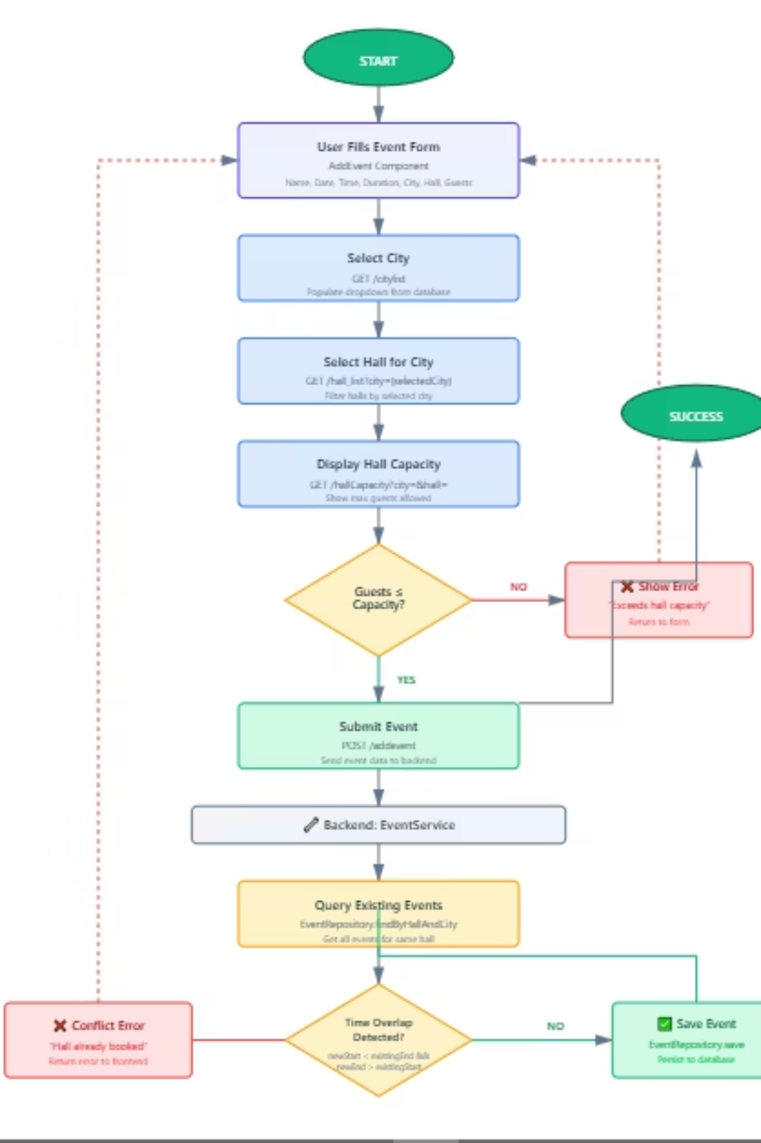
Event Workflow & Intelligent Processing
From submission to execution, the workflow handles the complete event lifecycle with intelligent conflict detection. The system validates capacity constraints, checks venue availability, detects time conflicts, and ensures data integrity before saving—all automatically. This minimizes human error and eliminates manual scheduling bottlenecks.
01
02
Form Submission
Validation Layer
User provides event details and preferences
AI checks capacity and time conflicts in real-time
03
Data Persistence
Approved events saved with referential integrity

Slide 17
Future Roadmap: Expanding EventMate's Capabilities
EventMate is positioned for significant growth. Our roadmap emphasizes personalization, real-time integration, and emerging technologies:
1
AI Personalization
Machine learning models analyze user preferences and past events to deliver intelligent venue and vendor recommendations tailored to each organizer's unique needs.
2
Live Availability APIs
Dynamic integration with venue providers enables instant pricing comparison, real-time availability, and one-click booking without manual coordination.
3
Predictive Analytics
Advanced algorithms forecast attendance, anticipate resource demands, and optimize costs—transforming reactive planning into proactive strategy.
4
Conversational Chatbot
Natural language understanding enables hands-free event planning through intelligent assistant support and automated scheduling interactions.
5
IoT & Cloud Integration
Connected sensors deliver live crowd monitoring, automated climate control, and intelligent lighting—creating seamless venue experiences.
6
Cross-Platform Apps
Native mobile and web applications ensure seamless access, real-time notifications, and synchronized planning across all devices.
7
Vendor Marketplace
Collaborative ecosystem enables vendor onboarding, client portals, and review systems—building a comprehensive event management community.
8
AR/VR Visualization
Immersive previews let organizers explore venue layouts and event setups in three dimensions before committing to bookings.

Slide 18
Thank You
Team EventMate
Transforming event planning through intelligent venue intelligence and data-driven decision-making.
Our Contributors
Naveen Kumar
Cherla Ashwini
Unnati Gupta
Sai Kumar
Rithika Kannan
Reimagining how event professionals connect with the perfect venues—one intelligent query at a time.

